Slide 1







National Oesophago-Gastric Cancer Audit
2018 Annual Report: Slide set

Slide 2
This slide set has been created to help NHS organisations to:
Summarise the findings from the NOGCA 2018 Annual Report for presentation at local meetings
Review their services and outcomes against those of other NHS trusts / local health boards, and against national figures where appropriate
Data from your NHS trust / local health board can be found in the Annexes of the 2018 Annual Report and added to the slides where indicated.

Slide 3
2018 Annual Report covers
Patients diagnosed with oesophago-gastric (OG) cancer between April 2015 and March 2017, in England and Wales
Patients diagnosed with oesophageal high-grade dysplasia (HGD) between April 2012 and March 2017, in England

Slide 4
High-grade dysplasia (HGD)
NOGCA received data on 2,059 patients diagnosed with HGD in NHS trusts between April 2012 and March 2017
The number of HGD records submitted to the Audit has declined each year
 | During period 2012-17
No. of patients | 2059
Male, n (%) | 1529 (74%)
Age in years, median (IQR) | 71 (64 to 79)
Patients with comorbidity, n (%) * | 383 (37%)
Source of referral, n (%)
Symptomatic | 1001 (53%)
Surveillance | 886 (47%)
*Collected from 2014; IQR – interquartile range

Slide 5
Indicators of HGD care
Indicators based on BSG recommendations | Patients diagnosed 2012-2017
% of patients whose first diagnosis was confirmed by a second pathologist ** | 86%
% of patients discussed at the multidisciplinary team (MDT) | 86%
% of patients who received endoscopic treatment | 65%
BSG – British Society of Gastroenterology guidelines on the diagnosis and management of Barrett’s oesophagus, 2014;
** Data collected for patients diagnosed from April 2014

Slide 6
The proportion of patients receiving active treatment for HGD increased from 70% in 2012-13 to 75% in 2016-17

Slide 7
% Patients receiving active treatment for HGD shows considerable variation across Cancer Alliances in England

Slide 8
Local HGD data
Review the management and treatment plans for HGD patients in your Cancer Alliance (2018 Annual Report, Annex 4) and compare these results with national figures
Indicator | National | Your Alliance
% of patients whose diagnosis was confirmed by a second pathologist | 86% | xx%
% of patients discussed at the multidisciplinary team (MDT) | 86% | xx%
% of patients who received endoscopic treatment | 65% | xx%

Slide 9
HGD recommendations
We recommend regular review of cases and submission to the Audit by local teams to improve case ascertainment in regions where it is currently low.
Where appropriate, MDTs should ensure that cases of suspected HGD have been confirmed by a second pathologist.
NHS trusts should ensure there are clear protocols with neighbouring hospitals for the referral of all cases of HGD to the specialist MDT. Local audits should be undertaken to check all cases are discussed and to take any required action.
MDTs should ensure that all patients with HGD are considered for endoscopic treatment, in line with current recommendations. Those with high rates of non-treatment should consider a local audit to investigate the reasons for this.
Where necessary, referral pathways to specialist centres should be established to ensure recommended volumes are achieved.

Slide 10
Oesophago-Gastric (OG) cancer
2018 Annual Report focuses on patients diagnosed with invasive epithelial OG cancer between April 2015 and March 2017, in England and Wales
Data from 139 NHS trusts (England) and 6 local health boards (Wales)

Slide 11
Local OG cancer data submissions
Review the number of OG cancer records submitted by your trust / local health board (2018 Annual Report, Annex 5) and compare these results with national figures. NB: NHS trusts / local health boards who submitted data on fewer than 10 curative surgical cases are not included in the Annex.
 | England | Wales | Your organisation
Records recorded | 19,769 | 1,263 | xx
% case ascertainment | 79.8% | 75.6% | xx
Review the quality of data submitted by your organisation by checking the completeness of surgical and pathology indicators (2018 Annual Report, Annex 6). The aim should be to achieve 100% completeness for all key indicators.

Slide 12
Route to diagnosis
Among patients diagnosed with OG cancer in 2015-17, 13% were diagnosed following an emergency admission. There was substantial variation in emergency diagnoses by Cancer Alliance / Welsh region
Use 2018 Annual Report Annex 7 to review results for your trust / local health board:
Locally, xx% of patients were diagnosed following an emergency admission

Slide 13
Tumour stage at diagnosis
The proportion of patients diagnosed with early stage cancer has remained at ~12% over the last five years

Slide 14
Staging investigations
Patients diagnosed with OG cancer are recommended to have a CT scan to identify metastatic disease
90% of patients diagnosed in 2015-17 had an initial CT scan
This proportion rose from 86% in 2012-13 to 90% in 2016-17
Use 2018 Annual Report Annex 8 to review results for your trust / local health board:
Locally, xx% of patients had an initial CT scan

Slide 15
Further staging investigations
PET-CT is recommended for all patients with oesophageal cancer being considered for curative treatment. Endoscopic ultrasound (EUS) is recommended to be used selectively for staging oesophageal cancers.
The use of PET-CT in patients with a curative treatment plan for oesophageal cancer increased from 63% in 2012-13 to 71% in 2016-17

Slide 16
Planned curative treatment
Overall, 39% of patients with OG cancer diagnosed in 2015–17 had a curative treatment plan
% patients managed with curative intent varied across Cancer Alliances / Welsh regions, but the values generally clustered around the national average

Slide 17
Planned palliative treatment
Patterns of planned palliative treatment varied across regions, with some having comparatively high rates of best supportive care

Slide 18
Curative surgery
Curative surgical records were submitted for 4,291 patients:
  2,658 oesophagectomies
  1,633 gastrectomies
 | Oesophagectomy |  | Gastrectomy
 | 2015-17 | 2013-15 | 2015-17 | 2013-15
30-day mortality | 2.4 | 1.6 | 1.3 | 1.9
90-day mortality | 3.9 | 3.2 | 3.3 | 4.1

Slide 19
Surgical Outcomes
All NHS Organisations achieved similar 90-day mortality after curative surgery
For 30-day postoperative mortality, one surgical centre had a rate that was slightly higher than expected given the volume of operations performed
Review the mortality rates for your trust / local health board using 2018 Annual Report Annex 9
30 day mortality
90 day mortality
Local 30 day mortality rate: xx%
Local 90 day mortality rate: xx%

Slide 20
Pathology outcomes after surgery
Last year, the Audit introduced results on four new surgical indicators.
A lack of standardisation in the preparation of surgical specimens prevents these indicators being used for benchmarking across organisations
Review the surgical indicators for your trust / local health board (2018 Annual Report, Annex 9) and compare these results with national figures
Indicator | National average | Your organisation
Proportion of patients with adequate lymph nodes examined | 82.5% | xx%
Proportion of patients with positive longitudinal margins- oesophagectomy | 3.6% | xx%
Proportion of patients with positive circumferential margins-oesophagectomy | 25.0% | xx%
Proportion of patients with positive longitudinal margins- gastrectomy | 8.2% | xx%

Slide 21
Palliative treatment
Among patients receiving palliative oncology, chemotherapy was most frequently used (see table)
Only 56% of patients having chemotherapy completed their treatment
Treatment modality | Oesophageal SCC n (%) | Oes ACA upper / mid n (%) | Oes ACA Lower / SI n (%) | GOJ SII/III n (%) | Stomach n (%)
Chemotherapy | 497 (53.9) | 180 (61.6) | 1087 (69.7) | 342 (75.5) | 679 (79.2)
Radiotherapy | 360 (39.1) | 97 (33.2) | 435 (27.9) | 104 (23.0) | 165 (19.3)
Chemo-radiotherapy | 65 ( 7.1) | 15 ( 5.1) | 37 ( 2.4) | 7 ( 1.6) | 13 ( 1.5)
Total | 922 | 292 | 1559 | 453 | 857

Slide 22
Palliative chemotherapy: triplet regimens
Guidelines recommend the use of triplet regimens (including a platinum-based agent, a fluoropyrimidine and an anthracycline) as a first line treatment option
There was regional variation in the use of triplet regimens, especially among patients aged 80 years and over

Slide 23
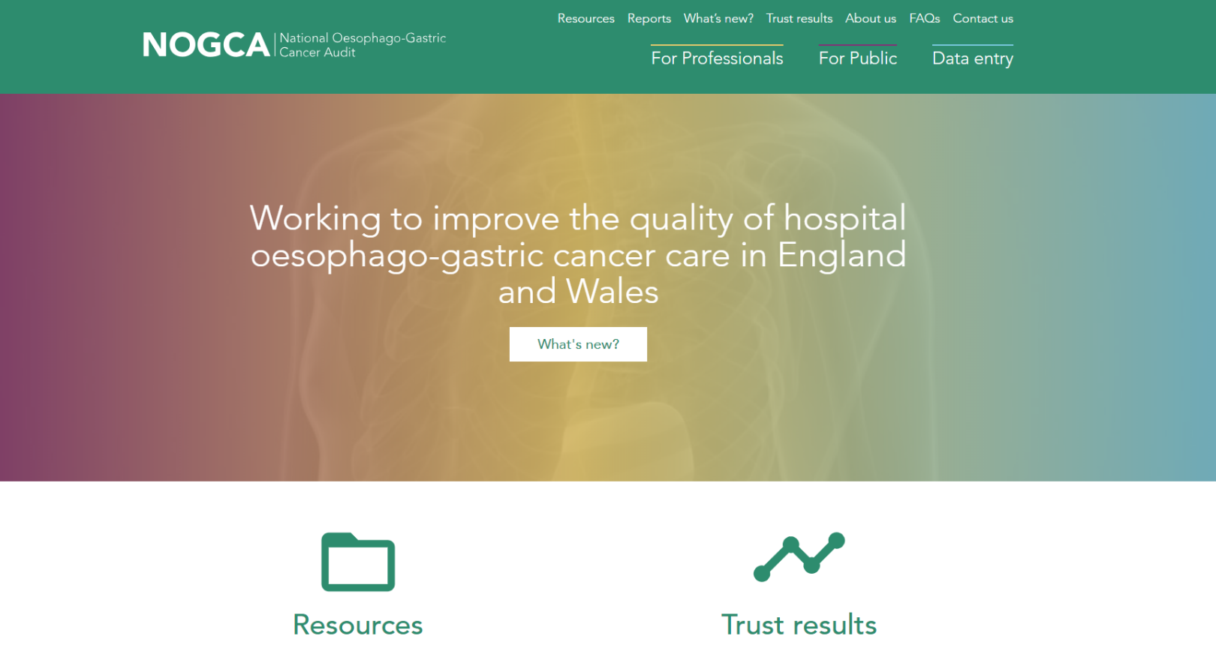
For further details: www.nogca.org.uk

